Slide 1
Cyclistic Bike-sharing Analysis (Case Study)
Aniket Chhaikuria
06/01/2024
Google Data Analytics Capstone

Slide 2
Maximizing Annual Memberships Insights From Cyclistic Bike-share Data
Welcome to the cyclistic bike-share analysis case study, where we delve into user behavior and ride patterns to optimize annual memberships. Using data from divvy trips for Q1 of 2019 and 2020, we aim to provide actionable insights to drive cyclistic's marketing strategy.

Slide 3
Overview
Objective
To understand how annual members and casual riders use Cyclistic bikes differently.
Business Goal
Provide insights to help convert casual riders into annual members.

Slide 4
Business task
Statement:
Analyze Cyclistic historical bike trip data to identify usage patterns and trends between annual members and casual riders.
Generate data-driven recommendations to increase annual memberships.

Slide 5
Data sources
Description:
Utilized Cyclistic's historical trip data from the previous divvy trips for Q1 of 2019 and 2020.
Data sourced from Motivate International Inc. under a public license.

Slide 6
Key findings
Ride frequency
Ride duration
Peak usage times
Annual Members: More consistent usage throughout the week, higher usage during weekdays.
Casual Riders: Higher usage during weekends, lower during weekdays.
Annual Members: Shorter, more frequent rides.
Casual Riders: Longer rides, often for leisure or exploration.
Annual Members: Peak during morning and evening commutes.
Casual Riders: Peak during midday and weekends.

Slide 7
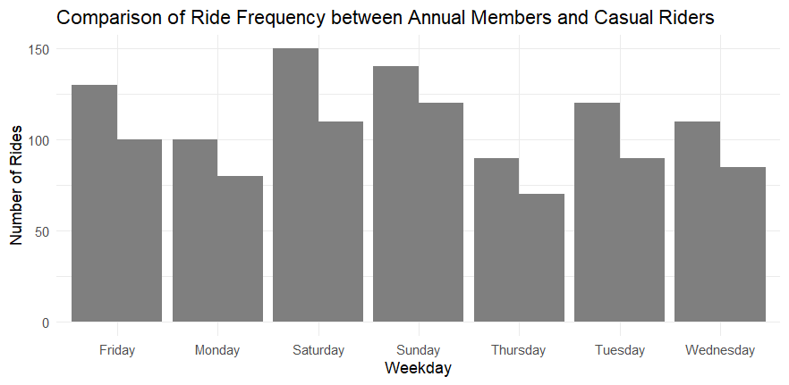

Slide 8
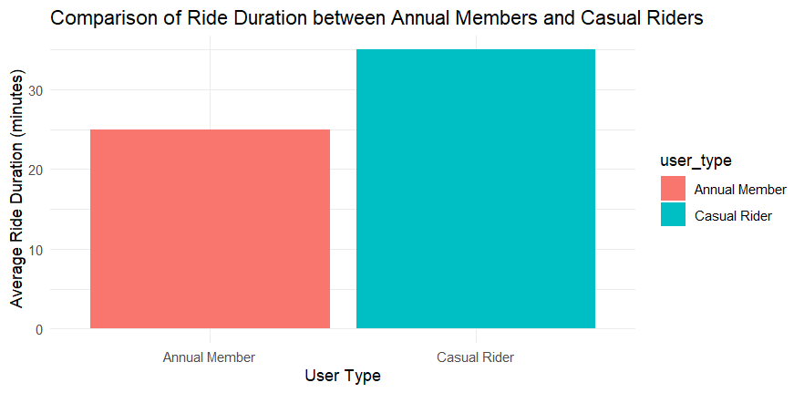

Slide 9
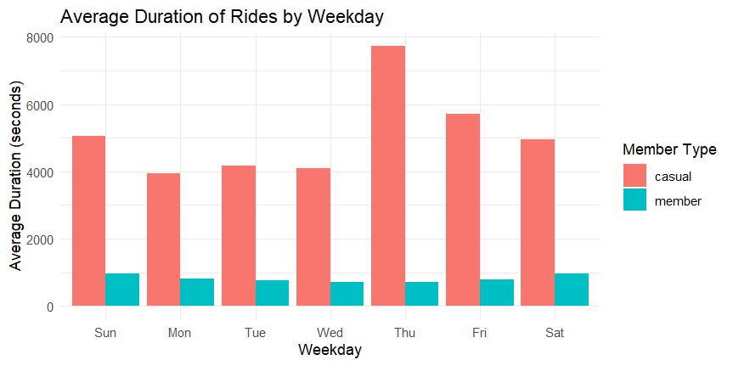

Slide 10
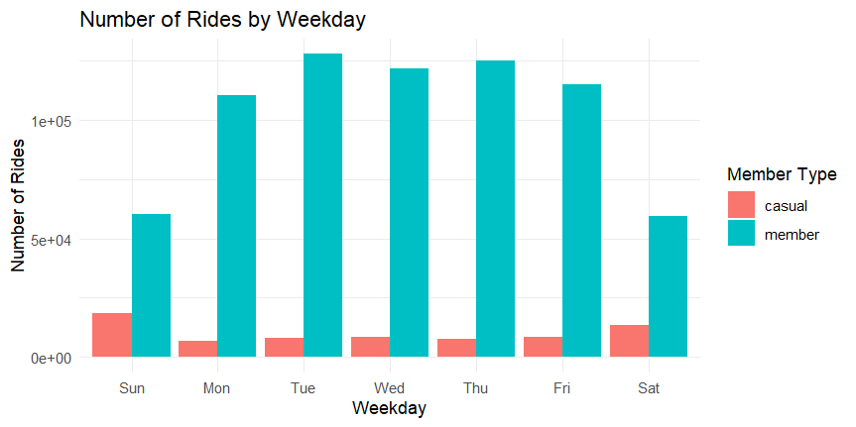

Slide 11
Recommendations
Targeted Marketing Campaign
Enhanced User Experience
Expanded Bike Options
Action: Develop campaigns aimed at casual riders during peak usage times (weekends and midday).
Benefit: Highlight benefits of annual memberships, such as cost savings and convenience for frequent users.
Action: Introduce features like personalized ride suggestions, loyalty programs, and seamless membership upgrades.
Benefit: Improve app interface to make purchasing memberships easier for casual riders.
Action: Increase availability of specialized bikes (e.g., cargo bikes, hand tricycles) to attract diverse user groups.
Benefit: Promote the inclusivity and flexibility of Cyclistic's bike options in marketing materials.

Slide 12
Conclusion
Summary:
Our analysis provides a clear understanding of the differences in usage patterns between annual members and casual riders. By implementing targeted marketing, enhancing user experience, and expanding bike options, Cyclistic can effectively convert casual riders into annual members.

Slide 13
Thank you for your attention. Q&A Does anyone have any questions?
Contact:
https://www.linkedin.com/in/aniketchhaikuria/
https://github.com/aniketchhaikuria

